Slide 1
The Travelling Salesman Problem
(TSP)
H.P. Williams
Professor of Operational Research
London School of Economics

Slide 2
A Salesman wishes to travel around a given set of cities, and return to the beginning, covering the smallest total distance
Easy to State
Difficult to Solve

Slide 3
If there is no condition to return to the beginning. It can still be regarded as a TSP.
Suppose we wish to go from A to B visiting all cities.
A
B

Slide 4
If there is no condition to return to the beginning. It can still be regarded as a TSP.
Connect A and B to a ‘dummy’ city at zero distance
(If no stipulation of start and finish cities connect all to dummy at zero distance)
A
B

Slide 5
If there is no condition to return to the beginning. It can still be regarded as a TSP.
Create a TSP Tour around all cities
A
B

Slide 6
A route returning to the beginning is known as a Hamiltonian Circuit
A route not returning to the beginning is known as a Hamiltonian Path
Essentially the same class of problem

Slide 7
Applications of the TSP
Routing around Cities
Computer Wiring - connecting together computer components using minimum wire length
Archaeological Seriation - ordering sites in time
Genome Sequencing - arranging DNA fragments in
sequence
Job Sequencing - sequencing jobs in order to minimise total set-up time between jobs
Wallpapering to Minimise Waste
NB: First three applications generally symmetric
Last three asymmetric

Slide 8
Major Practical Extension of the TSP
Vehicle Routing - Meet customers demands within given time windows using lorries of limited capacity
10am-1pm
7am-8am
3am-5am
4pm-7pm
6pm-7pm
Depot
8am-10am
6am-9am
2pm-3pm
Much more difficult than TSP

Slide 9
History of TSP
1800’s Irish Mathematician, Sir William Rowan Hamilton
1930’s Studied by Mathematicians Menger, Whitney, Flood etc.
1954 Dantzig, Fulkerson, Johnson, 49 cities (capitals of USA states) problem solved
64 Cities
1975 100 Cities
1977 120 Cities
1980 318 Cities
1987 666 Cities
1987 2392 Cities (Electronic Wiring Example)
1994 7397 Cities
13509 Cities (all towns in the USA with population > 500)
15112 Cities (towns in Germany)
24978 Cities (places in Sweden)
But many smaller instances not yet solved (to proven optimality)
But there are still many smaller instances which have not been solved.

Slide 10
Recent TSP Problems and Optimal Solutions from
Web Page of William Cook, Georgia Tech, USA with Thanks

Slide 11
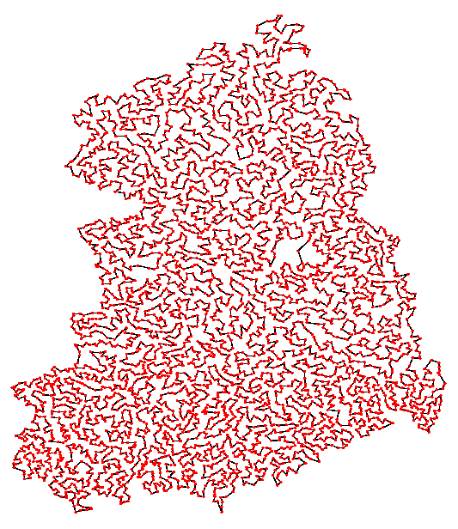
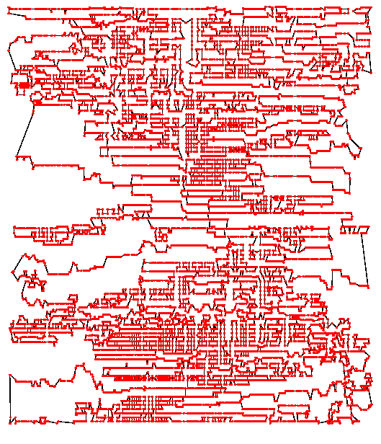
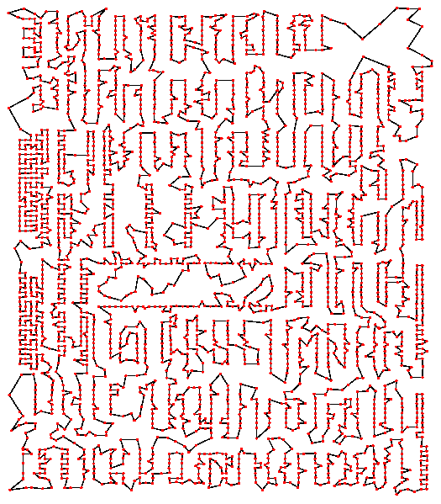
2004
n=24978
1998
n=13509
1954_x000b_n=49
1962_x000b_n=33
1977_x000b_n=120
1987_x000b_n=532
1987
n=666
1987
n=2392
1994
n=7397
n=1512
Printed Circuit Board 2392 cities 1987 Padberg and Rinaldi
 |  |  | TSP History > TSP in Pictures > 2004: 24978
 |  |  | Home | TSP History | Back
 |  |  | Last Updated: Jan 2005

Slide 12
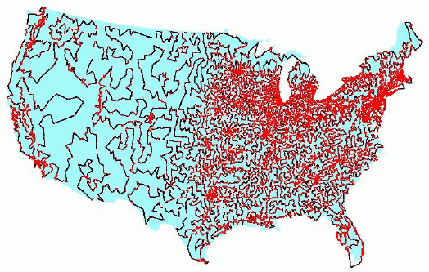
USA Towns of 500 or more population 13509 cities 1998 Applegate, Bixby, Chvátal and Cook

Slide 13

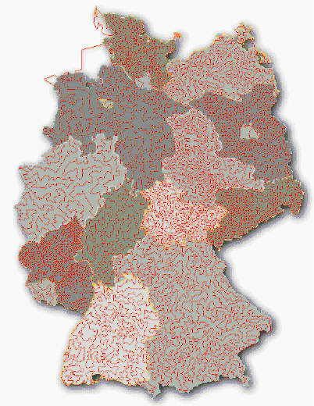
Towns in Germany 15112 Cities 2001Applegate, Bixby, Chvátal and Cook

Slide 14
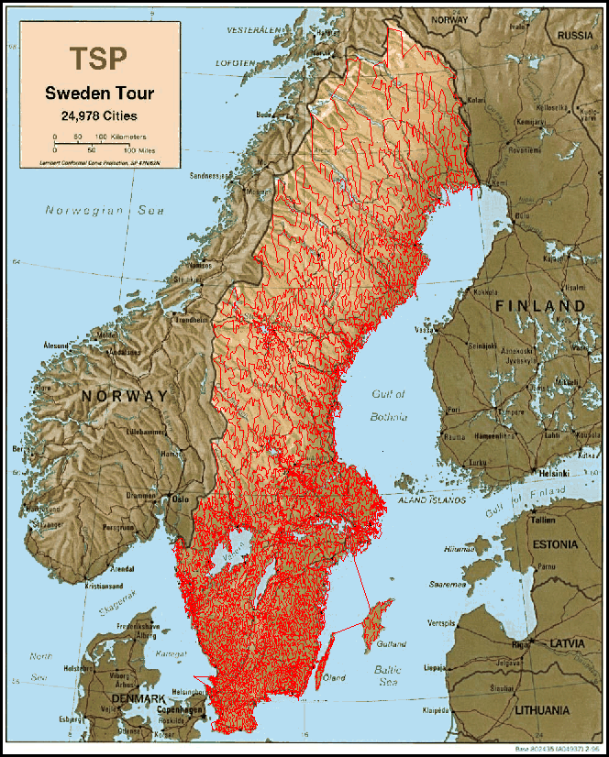
Sweden 24978 Cities 2004 Applegate, Bixby, Chvátal, Cook and Helsgaun

Slide 15
Solution Methods
Try every possibility (n-1)! possibilities – grows faster than exponentially
If it took 1 microsecond to calculate each possibility
takes 10¹⁴⁰ centuries to calculate all possibilities when n = 100
Optimising Methods obtain guaranteed optimal solution, but can take a very, very, long time
III. Heuristic Methods obtain ‘good’ solutions ‘quickly’ by intuitive methods.
No guarantee of optimality
(Place problem in newspaper with cash prize)

Slide 16
The Nearest Neighbour Method (Heuristic)
– A ‘Greedy’ Method
Start Anywhere
Go to Nearest Unvisited City
Continue until all Cities visited
Return to Beginning

Slide 17
A 42-City Problem The Nearest Neighbour Method (Starting at City 1)
5
25
8
31
37
24
6
28
32
36
41
26
30
14
27
11
15
7
23
9
40
33
22
29
12
13
2
19
34
35
42
20
16
38
17
4
21
10
3
1
39
18

Slide 18
The Nearest Neighbour Method (Starting at City 1)
5
25
8
31
37
24
6
28
32
36
41
26
30
14
27
11
15
7
23
9
40
33
22
29
12
13
2
19
34
35
42
20
16
38
17
4
21
10
3
1
39
18

Slide 19
The Nearest Neighbour Method (Starting at City 1) Length 1498
5
25
8
31
37
24
6
28
32
36
41
26
30
14
27
11
15
7
23
9
40
33
22
29
12
13
2
19
34
35
42
20
16
38
17
4
21
10
3
1
39
18

Slide 20
Remove Crossovers
5
25
8
31
37
24
6
28
32
36
41
26
30
14
27
11
7
15
23
40
33
9
22
29
12
13
2
19
34
35
42
20
16
38
17
4
21
10
3
1
39
18

Slide 21
Remove Crossovers
5
25
8
31
37
24
6
28
32
36
41
26
30
14
27
11
7
15
23
40
33
9
22
29
12
13
2
19
34
35
42
20
16
38
17
4
21
10
3
1
39
18

Slide 22
Remove Crossovers Length 1453
5
25
8
31
37
24
6
28
32
36
41
26
30
14
27
11
7
15
23
40
33
9
22
29
12
13
2
19
34
35
42
20
16
38
17
4
21
10
3
1
39
18

Slide 23
Christofides Method (Heuristic)
Create Minimum Cost Spanning Tree (Greedy Algorithm)
‘Match’ Odd Degree Nodes
Create an Eulerian Tour - Short circuit
cities revisited

Slide 24
Christofides Method 42 – City Problem
Minimum Cost Spanning Tree
5
8
Length 1124
25
31
24
37
6
28
26
30
32
36
27
41
14
11
23
7
33
15
22
9
40
29
12
13
2
35
19
34
42
38
20
16
17
4
21
10
3
39
18
1

Slide 25
Minimum Cost Spanning Tree by Greedy Algorithm
Match Odd Degree Nodes

Slide 26
Match Odd Degree Nodes in Cheapest Way – Matching Problem
5
5
8
8
25
25
31
31
37
24
37
24
6
6
28
28
30
30
36
26
36
26
32
32
27
27
11
41
11
41
14
14
23
23
7
7
33
33
22
15
22
15
9
9
29
40
29
40
12
12
2
13
2
13
35
35
19
19
34
42
34
42
38
20
38
20
16
16
21
21
10
17
10
17
4
4
3
3
39
39
1
18
1
18

Slide 27
Create Minimum Cost Spanning Tree (Greedy Algorithm)
‘Match’ Odd Degree Nodes
Create an Eulerian Tour - Short circuit
cities revisited

Slide 28
Create a Eulerian Tour – Short Circuiting Cities revisited
Length 1436
5
8
25
31
37
24
6
28
36
32
41
26
27
30
14
11
7
15
23
40
33
9
22
29
12
13
2
19
34
42
35
20
16
38
17
4
21
10
3
1
39
18

Slide 29
Optimising Method
1.Make sure every city visited once and left once – in cheapest way (Easy)
-The Assignment Problem - Results in subtours Length 1098
5
8
25
31
37
24
6
28
36
32
41
26
30
14
27
11
7
15
23
40
33
9
22
29
12
13
2
19
42
34
35
20
16
38
17
4
21
10
3
1
39
18

Slide 30
Put in extra constraints to remove subtours (More Difficult)
Results in new subtours Length 1154
5
8
25
31
37
24
6
28
36
41
32
14
26
30
27
7
11
15
23
40
33
9
22
29
12
13
2
19
34
42
35
20
16
38
17
4
21
10
3
1
39
18

Slide 31
Remove new subtours
Results in further subtours Length 1179
5
8
25
31
37
24
6
28
36
32
41
26
30
14
27
11
7
15
23
40
33
9
22
29
12
13
2
19
42
34
35
20
16
38
17
4
21
10
3
1
39
18

Slide 32
Further subtours Length 1189
5
8
25
31
37
24
6
28
36
32
41
26
30
14
27
11
7
15
23
40
33
9
22
29
12
13
2
19
42
34
35
20
16
38
17
4
21
10
3
1
39
18

Slide 33
Further subtours Length 1192
5
8
25
31
37
24
6
28
32
36
41
26
30
14
27
11
7
15
23
40
33
9
22
29
12
13
2
19
42
34
35
16
20
38
17
4
21
10
3
1
39
18

Slide 34
Further subtours Length 1193
5
8
25
31
37
24
6
28
32
36
41
26
30
14
27
7
11
15
23
40
33
9
22
29
12
13
2
19
42
34
35
20
16
38
17
4
21
10
3
1
39
18

Slide 35
Optimal Solution Length 1194
5
8
25
31
37
24
28
36
6
32
41
26
30
14
27
11
7
15
23
40
33
9
22
29
12
13
2
19
42
34
35
20
16
38
17
4
21
10
3
1
39
18

